Slide 1

Man-in-the-Browser (MITB) Attack
Defense Strategies
ELEC 591: Professional Practice
Team - Security Shields
Maninder Singh
V00879900
Prabhjot Kaur
V00877155
Barath Gosakan
V00874048
Olumide owoyomi V00855280
Mei Jia Liu
V00872728

Slide 2
Introduction
MITB Functionality
MITB Attack Types
Proposed Solution
Conclusion
Future Work
References
Table of Contents

Slide 3
Introduction to MITB
“Man-in-the-Browser(MITB) is a form of Internet threat related to Man-in-the-Middle(MITM), it’s a Trojan (sometimes called proxy Trojans) that infects a web browser and has the ability to modify pages, modify transaction content or insert additional transactions, all in a completely covert fashion invisible to both the user and host application” ,OWSAP
Characteristics
Run during the time victim is online
Performed silently without asking the victim for anything
The fraudulent transactions seems done from victim’s computer
Extremely hard to detect and/or investigate

Slide 4
How it is different than other browser attacks?
Introduction to MITB
Man-in-the-Middle attack
The attacker lies between the victim client and the server
Can be defeated by encrypting traffic e.g., using SSL
Compromised host with the Trojan/rootkit
Exploit victim’s system and installs Trojan to maintain full access to the OS and monitor activities of the user including logging keystrokes
Cannot be defeated using encryption, however, it can be defeated using multi-factor authentication, e.g. OTP or Biometric
Man in the browser
Blend of the above two attacks
It is a Trojan in the form of BHO (Browser help Object)/ActiveX Controls/ Browser Extension/Add-on/Plugin
The Trojan installs itself as a part of the victim’s client itself (i.e. the browser)
Neither encryption nor OTP can defeat MITB attacks

Slide 5
MITB Functionality
There are many Trojan families used to conduct MITB attacks
Zeus
Most used and effective crime ware kit ever observed by Internet security community
Requires less skills for attackers to use
Antivirus detection rate is very less
Silent Banker
Intercept data sent from victim to bank
Able to steal OTP codes
Local HTML injections to mimic the design of targeted bank website

Slide 6
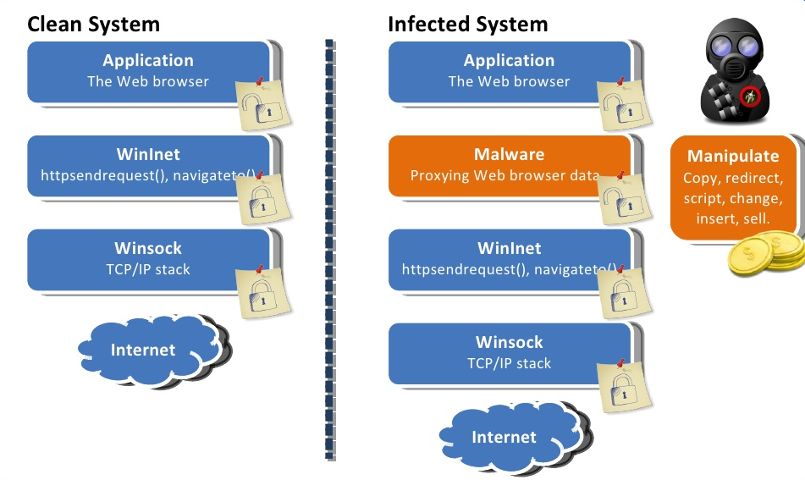
MITB Functionality
URL Zone
Disables use of proxy
Monitors access of online banking sites.
Antivirus evasion
Gozi

Slide 7
MITB Attack Types
1.Browser Helper Objects
Used in Browser for added Functionality
Runs at system level Privileges
MITB attacks can use browser helper objects to change a site, adding fields or removing fields
2.DOM Module Interface
Document Object Model is to provide a standard programming
Used in event handling
The Trojan is inserted into the event handling registers that modifies the data you enter

Slide 8
MITB Attack Types
3.Java script and AJAX
Capability to perform actions invisible to the end-user
The ability to override prototypes of built-in DOM methods
This is used by Zeus to perform code injection add additional fields to steal sensitive data
4.API Hooking
This allows the attacker to modify what a user sees in the browser
This is similar to HTML rewriting

Slide 9
MITB Attack Types
5.Session Hijacking
Also known as cookie hijacking is the exploitation of a valid computer session by gaining access to session key
To gain unauthorized access to information or services in a computer system.
In particular, it is used to refer to the theft of a magic cookie used to authenticate a user to a remote server

Slide 10
Suggested Solutions
Anti-Virus or Anti-malware applications
Separate computer used for online banking
Tougher browsing methods. Ex: disabling USB drives and auto-run on systems
OTP token with signatures
Out of band transaction detail confirmation plus OTP
Cookie encryption

Slide 11
Conclusion
February, 2017-March 1, 2017
Research bank system security schemes in recent years
March 1, 2017-March 15, 2017
The research subject was confirmed, MITB is the attack between the
user and the browser
March 16, 2017-April 1, 2017
Analyze the functionality and types of MITB attack and present suggested
counter measures. Active counter measures contain OTP token with signatures, the
Out-of-Band transaction confirmation with OTP, Anti-Virus applications, and so on

Slide 12
Future Work
April 7, 2017-May 1, 2017
Active counter measures implementation and improving
method in MITB attacks
May 1, 2017-May 15, 2017
Analyze passive counter measures, including IP-Geolocation,
device-profiling and monitor user behavior
May 15, 2017-May 31, 2017
Combining active measures with passive measures to implement
protection of online bank security more efficiently with lower cost

Slide 13
References
Entrust Security Solutions, “Defeating Man in the Browser malware”., 24002/3-1418 , Mar. 2014
“Averting Man In The Browser Attack using User-Specific Personal Images” by Puneet Goyal ,Bansal and Neeraj Gupta , IACC 2013
https://www.w3.org/TR/DOM-Level-2-Core/introduction.html
SANS institute “Analysing Man in the Browser Attacks”
Chickowski, Ericka; “Man in the Mobile Attacks Highlight Weaknesses in Out-of-band Authentication,” 2010,www.darkreading.com/authentication/167901072/security/application-security/227700141/man-in-the-mobile-attacks-highlight-weaknesses-in-out-of-band-authentication.html
Entrust Inc., “Defeating Man-in-the-Browser: How to Prevent the Latest Malware Attacks Against Consumer and Corporate Banking,” 2010, http://docs.bankinfosecurity.com/files/whitepapers/pdf/315_WP_MITB_March2010.pdf

Slide 14


Slide 15


